Slide 1
WEBSITE PROJECT
DESAROLLO DE APLICACIONES WEB I
Sprint II
LUDOVICO GHERGO
GIACOMO MOSSIO
RAFAŁ JAGIELSKI ANDREA MERICI

Slide 2
Preliminary description
New implementations:
Responsive Web Page
Dynamicity with JSON
Constraint validation
Implementation of JavaScript and Ajax

Slide 3
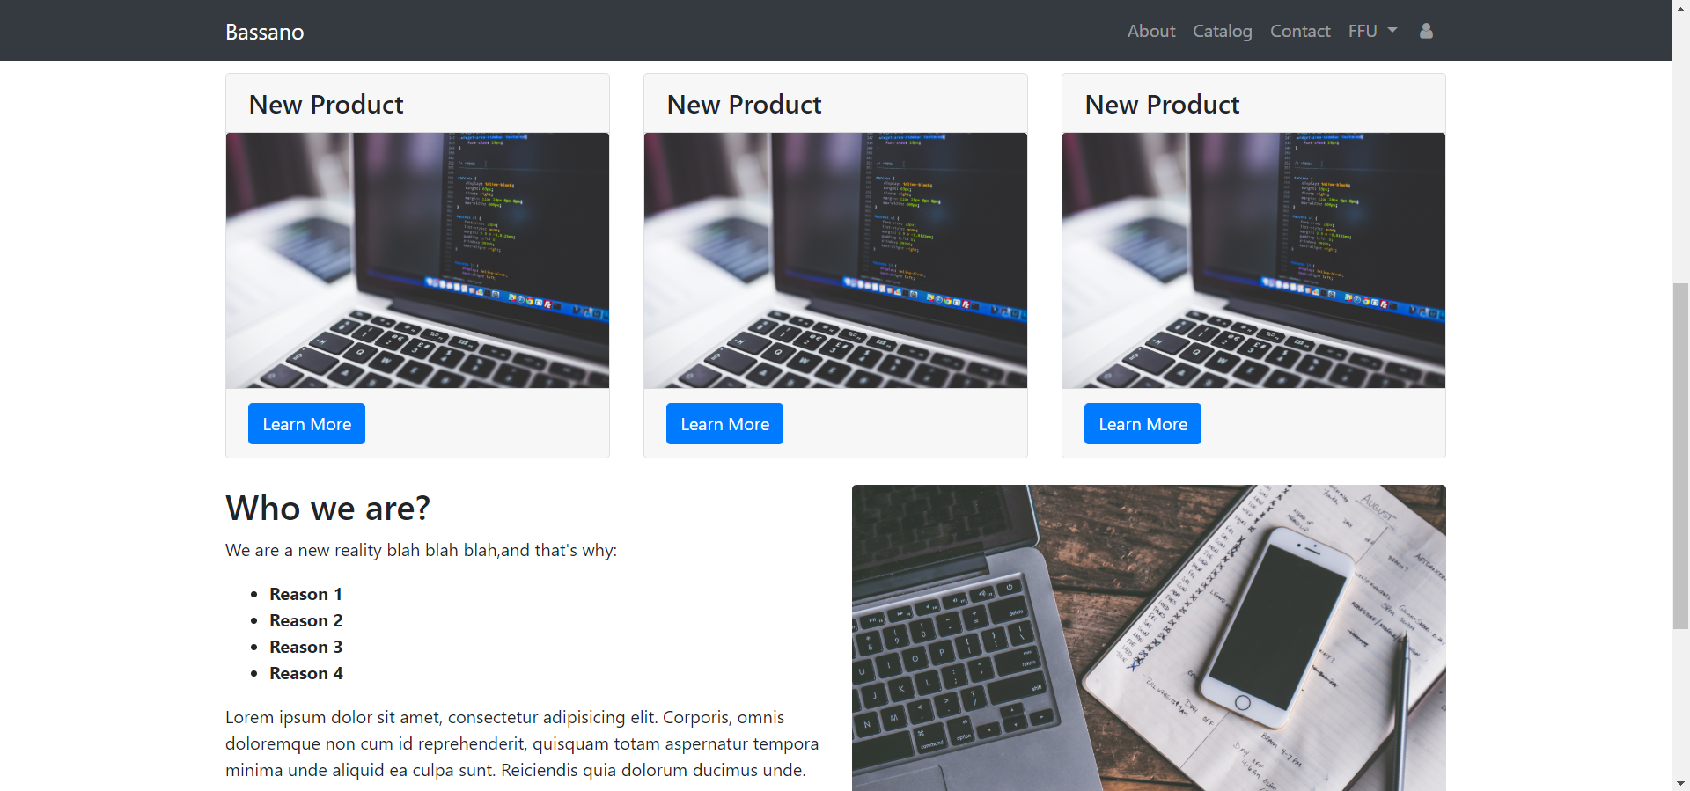
Responsive Web Design
Full screen resolution:
1920 x 900 pixels

Slide 4
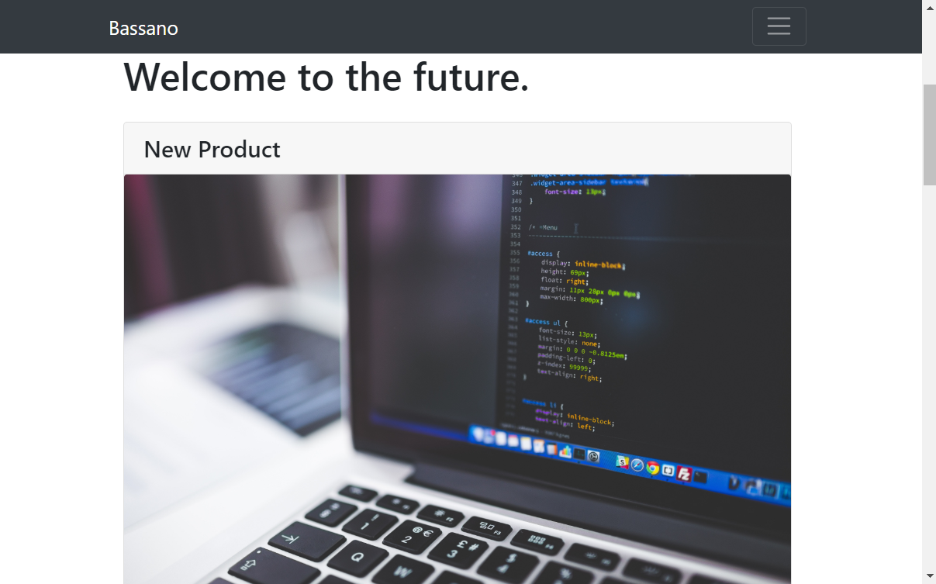
Responsive Web Design
Minimized resolution:
1207 x 573 pixels

Slide 5
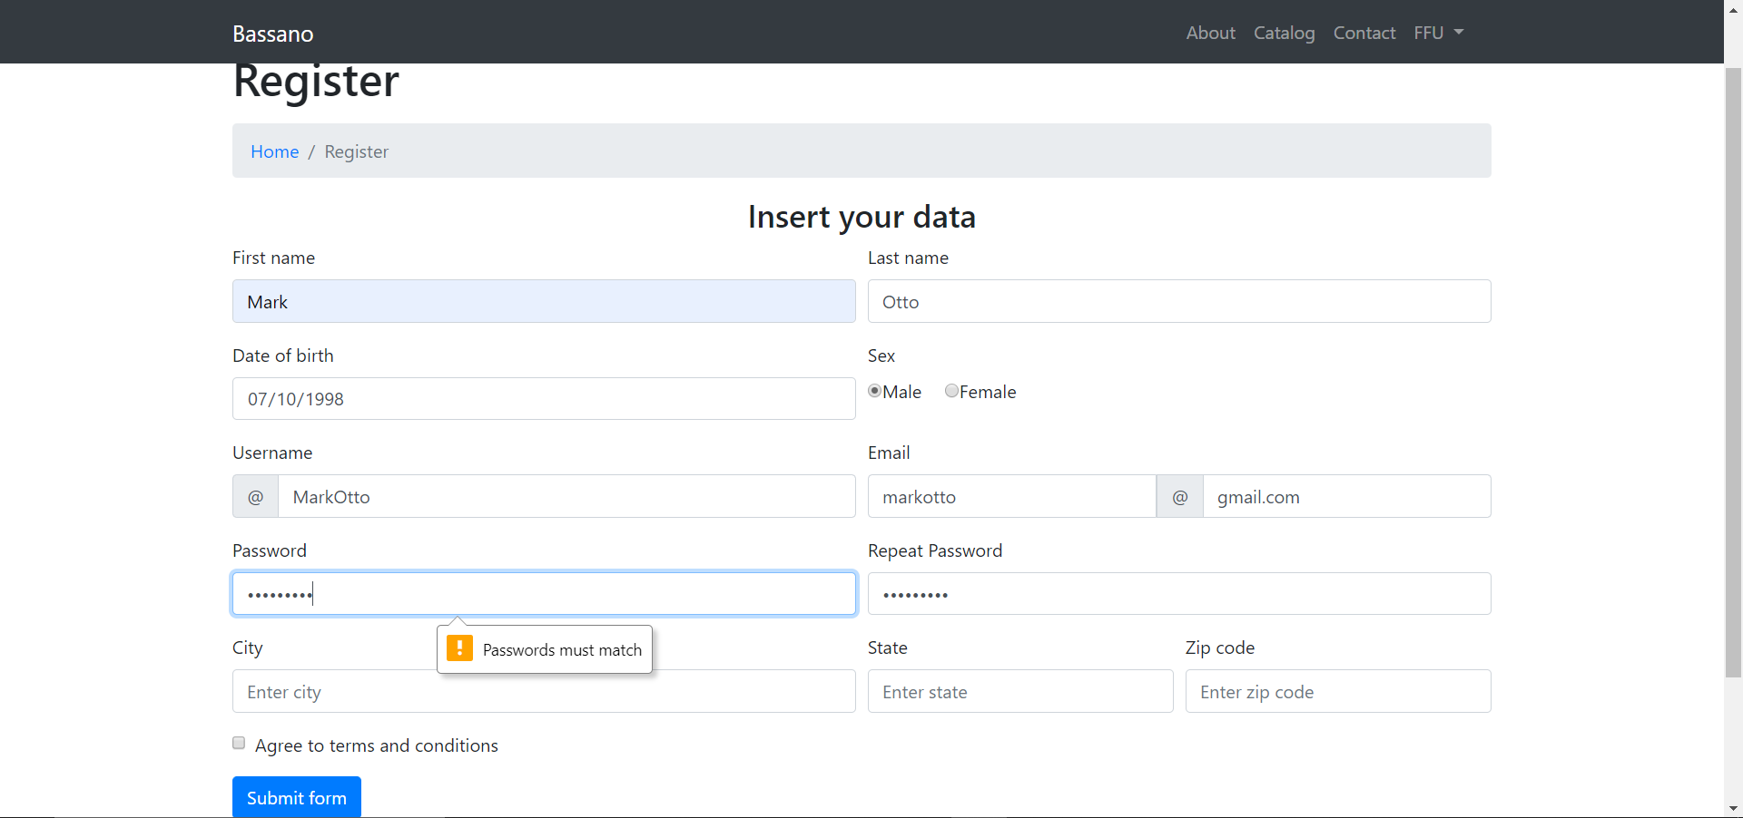
Constraint Validation
Using types and attributes of HTML
Using JavaScript for matching passwords

Slide 6
Dynamicity with JSON
We implemented JSON for reading usefull data from a remote database
When the catalog page is shown, it will read the product names and informations from JSON
Everytime we click on a product, the site will use a cookie for reading from JSON
The comments are dynamic too thanks to JSON

Slide 7
Implementation of JavaScript and AJAX

